Slide 1
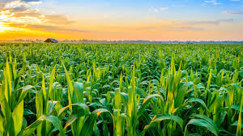
Agricultural Techniques
AKA Types of Farming

Slide 2
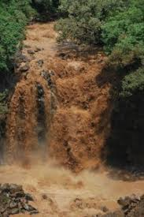
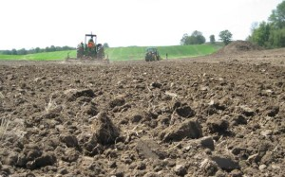
Sustainability of Agriculture
Sustainability is how the processes used today impact the ability to use the land in the future.
Non-sustainable agriculture
Large amounts of soil erodes
Use chemicals to grow & protect plants (fertilizer, insecticides, fungicides, etc.)

Slide 3
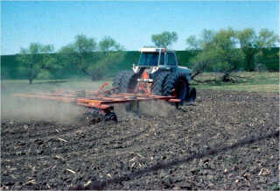
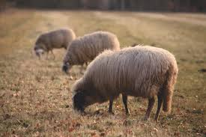
Non-Sustainable Agriculture Techniques
Traditional Farming
Plow (turn over) soil after each season
Removes plant stalks, roots, and loosens soil
Causes the most erosion
Graze large numbers of livestock (animals) together
Called overgrazing
Kills plants (eaten faster than they can regrow)

Slide 4
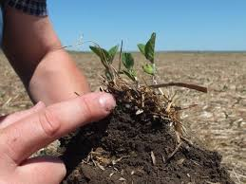
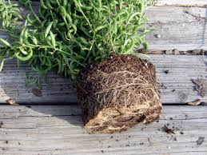
Sustainability of Agriculture
Sustainability is how the processes used today impact the ability to use the land in the future.
Sustainable agriculture
Minimizes erosion (but it still happens!)
Minimizes the addition of chemicals

Slide 5
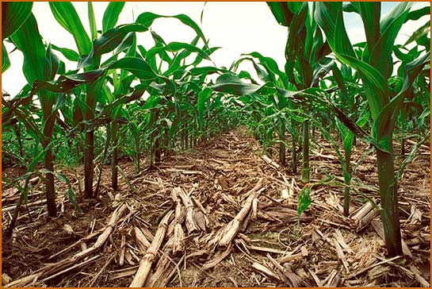
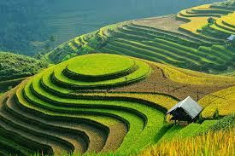
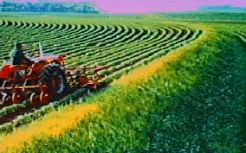
Sustainable Agriculture Techniques
No-till Farming
Leave plant stalks rooted in fields (do not plow)
Terracing
Make hills into steps and farm on the flat areas
Contour Farming
Plant along the shape of the land

