Slide 1
Ocean Basics

Slide 2
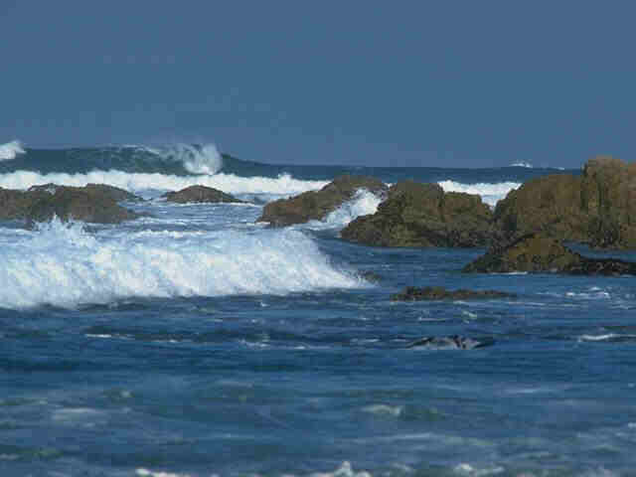
Oceans
The oceans contain 97% of the water on Earth.
The remaining 3% is freshwater.

Slide 3
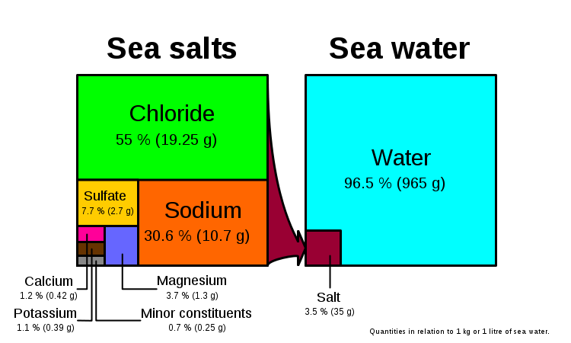
Ocean Water Composition
Dissolved salts, gases, and nutrients are present in seawater in the form of ions (charged particles).
As marine organisms die, their solid parts drift to the bottom of the ocean and decay, releasing salts into the seawater.

Slide 4
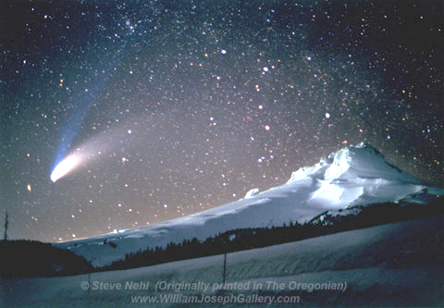
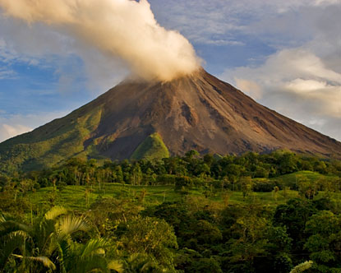
Source of Earth’s Oceans
Comets containing ice.
Volcanoes (volcanism):
Water deep within Earth’s interior is brought to the surface.
After volcanoes spewed water vapor, the crust cooled and the water vapor condensed to form oceans.

Slide 5
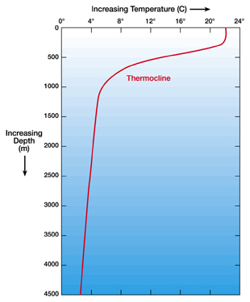
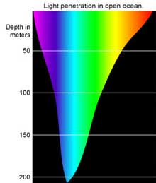
Temperature Layers
Surface Layer: warm, light, up to 100 m deep
Thermocline: rapidly decreasing temperature with depth.
The warm surface layer and thermocline are absent in the polar regions.
IT IS ALL COLD!! ☺
Notes:
Average ocean depth = 4,267 meters (14,000 feet). = 2.7 miles deep
Deepest part of ocean = 11,030 meters (36,200 feet) deep. = 6.9 miles deep

