Slide 1
Freshwater Pollution
Source Types
Surface Types
Conservation

Slide 2
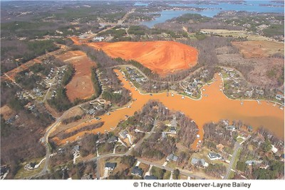
Pollution . . .
. . . is anything that lowers water quality
Chemicals (lead, mercury, arsenic, fertilizers, oil, industrial waste, etc.)
Sediment (biggest pollutant in NC streams)
Objects
2 types of sources
Point
Nonpoint

Slide 3
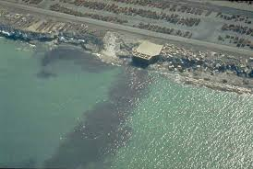
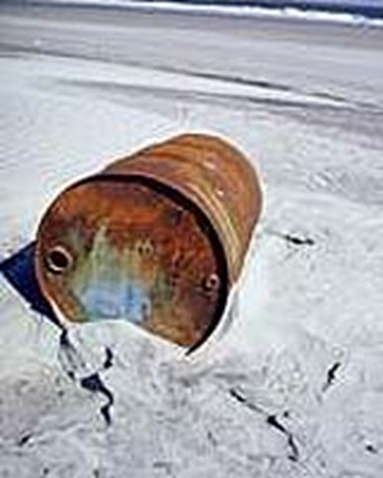
1. Point Source Pollution
A specific location that is the clear source of a pollutant
Examples:
Hazardous material wells
Factory outputs
Leaking containers

Slide 4
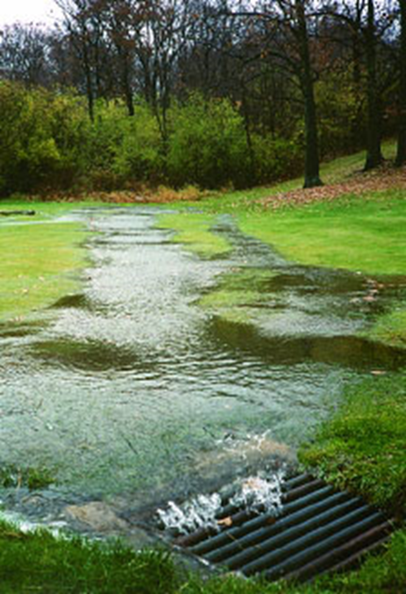
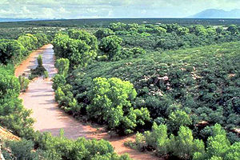
2. Nonpoint Source Pollution
Generalized source of pollution, usually in runoff
Examples:
Main source: Agricultural runoff (fertilizer, animal waste, sediment)
Sedimentation (from deforestation, farming, & housing developments)
Storm water runoff (roads)

Slide 5
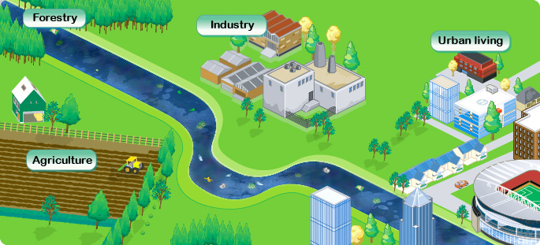
Pollution . . .
Pollution moves downstream with water
More pollution = lower water quality
Downstream = poorest water quality

Slide 6
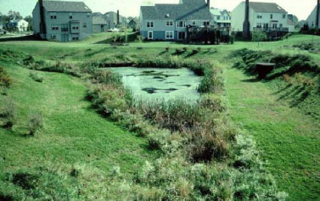
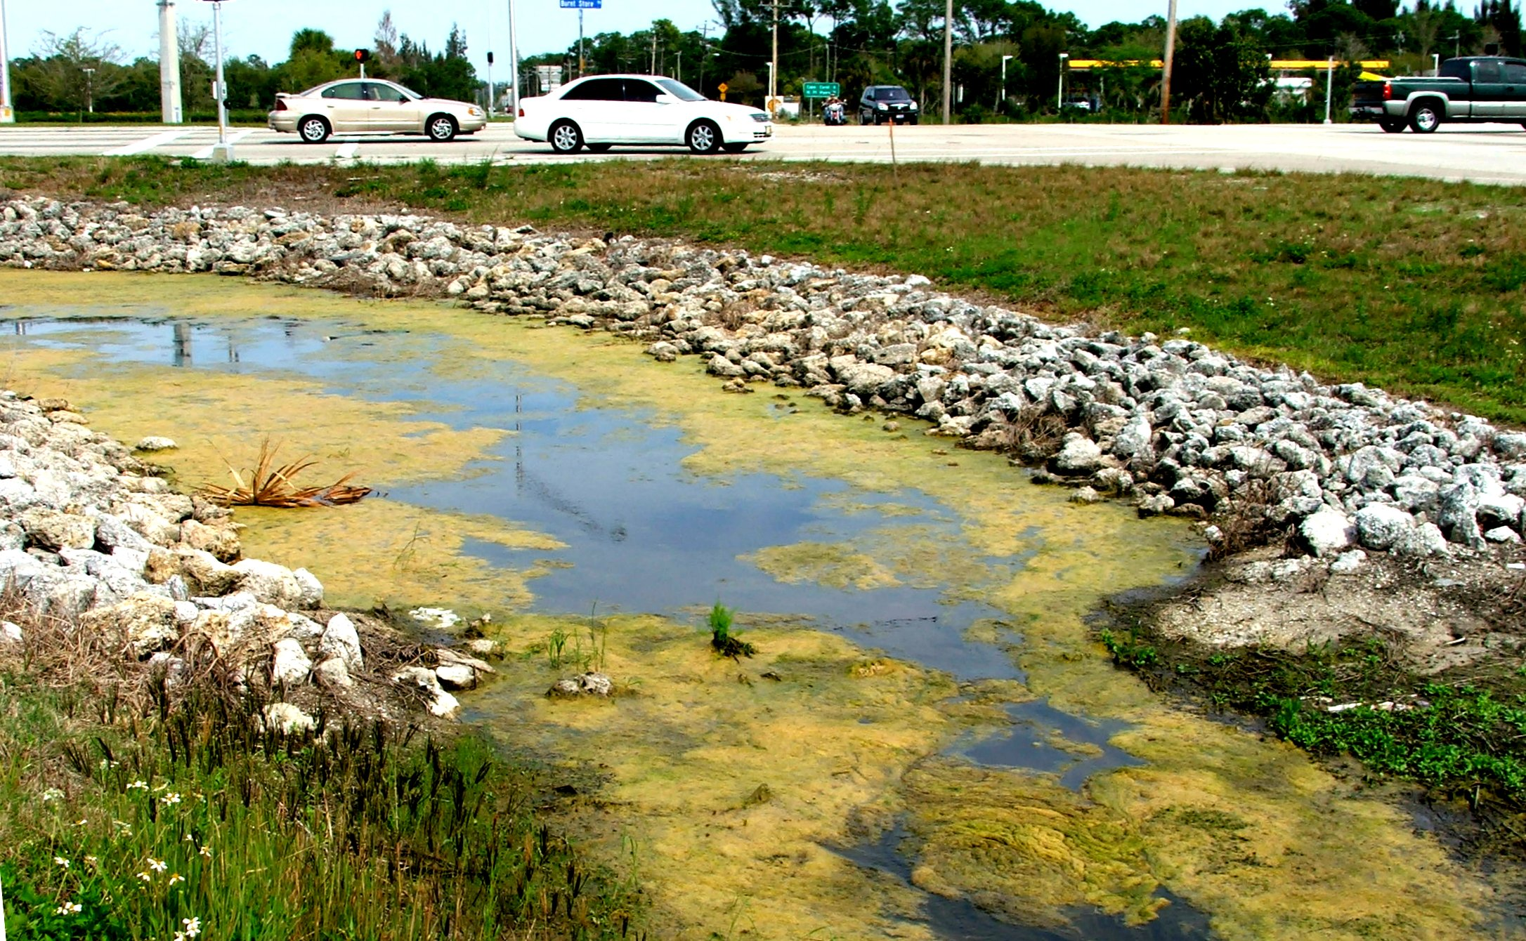
Reducing Nonpoint Pollution
Decrease runoff/erosion
Increase vegetation
Decrease slope angles
Use terracing, no-till farming, and contour farming
Capture runoff in retention ponds

Slide 7
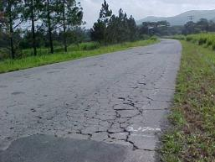
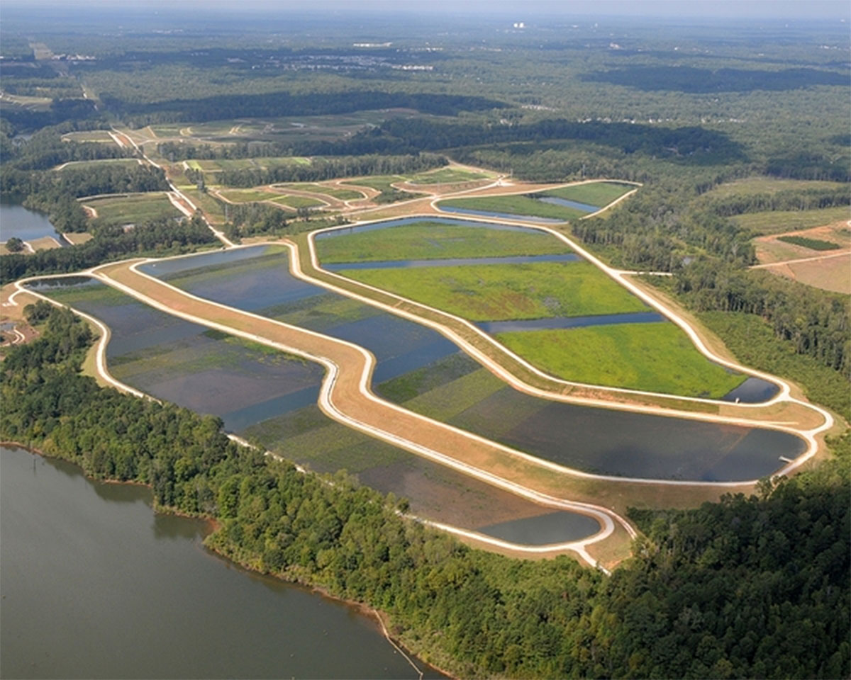
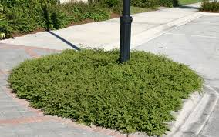
Surface Types
Type of ground covering in river systems
Major factor in how much and what type of pollution reach water bodies
Permeable surfaces
Estuaries (aka marshland)
Impermeable surfaces

Slide 8
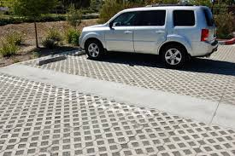
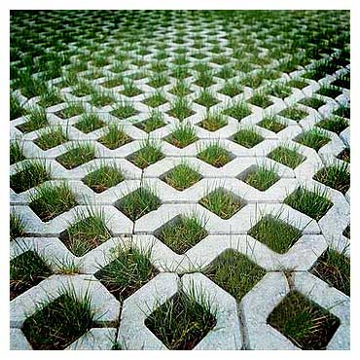
Surface Type: 1. Permeable Surfaces
Permeable surfaces allow water to permeate (soak into) soil.
Decreases the amount of runoff
Infiltration = some pollutants are removed from the water (trapped by the soil)
Examples: fields, forests, specialized pavement

Slide 9
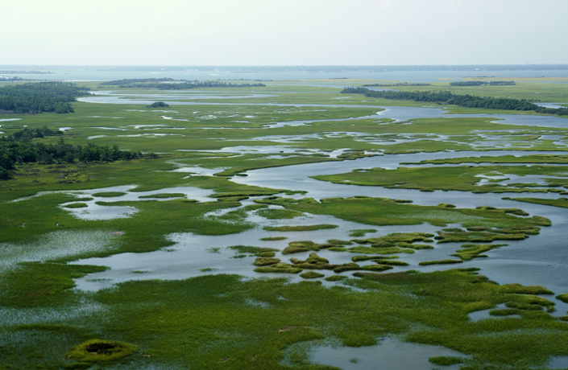
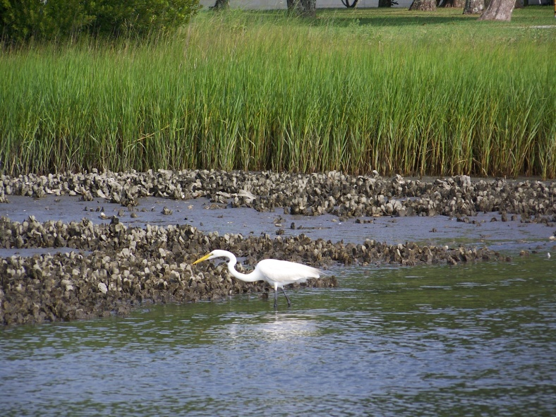
Surface Type: 2. Estuaries
Estuaries are permeable surfaces that have very slow infiltration rates.
Greatly reduce runoff into the water
Slow infiltration = very effective removal of pollutants
Act as natural flood control area

Slide 10
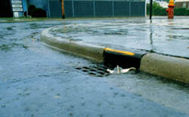
Surface Types: 3. Impermeable Surfaces
Impermeable surfaces are completely solid and thus do NOT permit water to infiltrate the soil.
Increase the runoff
Allows NO infiltration
NO infiltration = NO removal of pollutants
Examples: concrete, asphalt, bricks, roofs

Slide 11
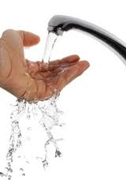
Water Conservation
Most water conservation efforts focus on conserving potable water.
Potable water = water safe for human consumption
As populations increase, there is a greater demand for potable water.
Supply drops
Cost increases

Slide 12
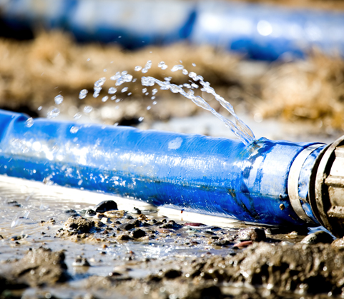
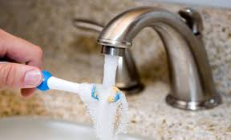
Potable Water Conservation: Reduce
Use less water
Turn off faucets when brushing teeth or hand-washing dishes
Shorter showers/less full baths
Run only full dishwasher & washing machine loads
Increased regulations & cost of water

Slide 13
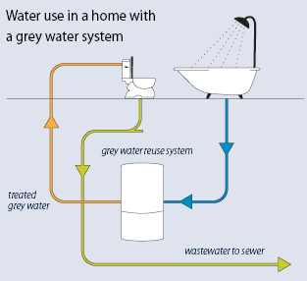
Potable Water Conservation: Recycle/Reuse
Use the same water multiple ways
Use “undesirable” water for plants (left in water bottles/cups, from pet’s dishes, etc.)
Wash vegetables in sink then use same water to soak dishes
Other ways?

