Slide 1
Weather Instruments

Slide 2
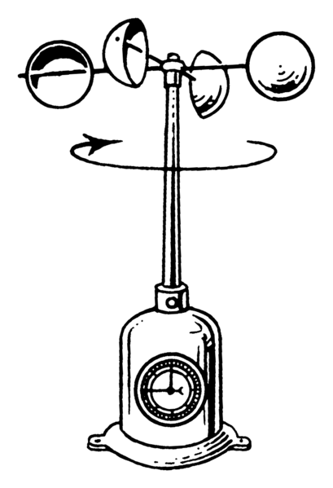
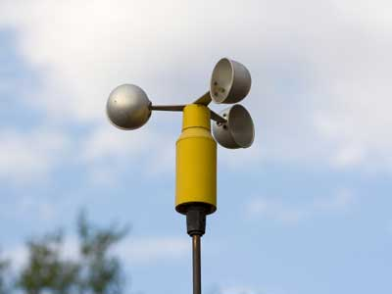
Anemometer
Used to measure wind speed
Units: mph (miles per hour), ft/min (feet per minute), & knots (nautical miles per hour)

Slide 3
Thermometer
Used to measure temperature conditions
Units: °F (Fahrenheit) & °C (Celcius)

Slide 4
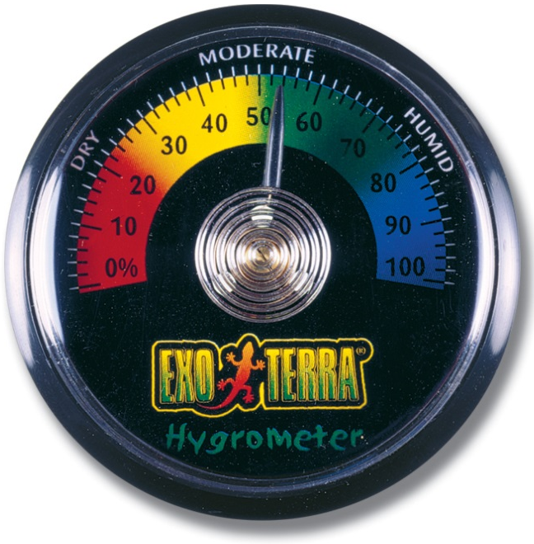
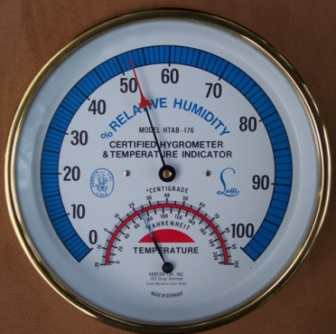
Hygrometer
Used to measure the humidity (amount of water vapor) in the air
Units: mL/cm³ (milliliters per centimeter cubed) or percentage (measuring relative humidity)

Slide 5
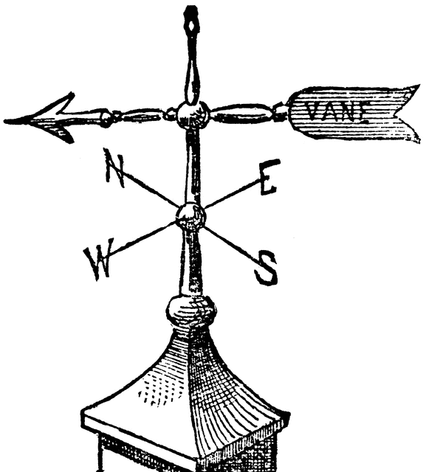
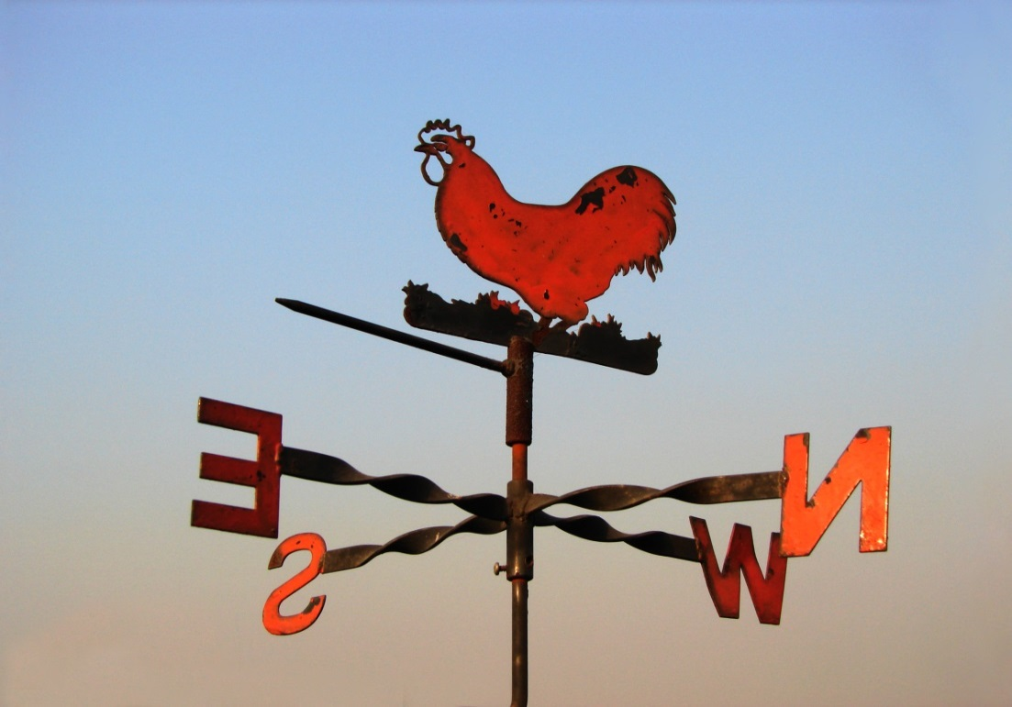
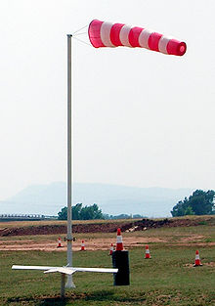
Wind Vane
Shows the direction the wind COMES FROM
Units: found on compass rose (N, S, E, W, NW, SE, etc.)
Could also use a wind sock for this purpose

Slide 6
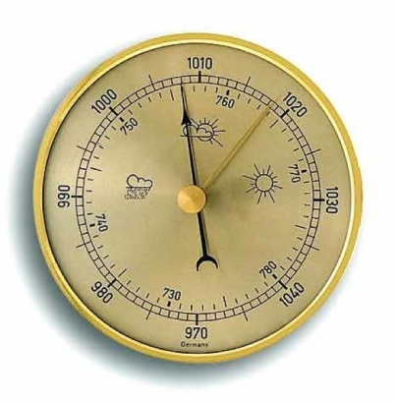
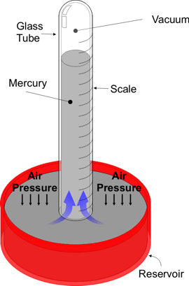
Barometer
Used to measure the atmospheric pressure
Units: millibars & inches or millimeters of mercury
Works by comparing how far the atmosphere pushes down on a liquid, like mercury.

Slide 7
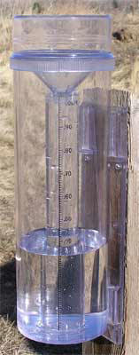
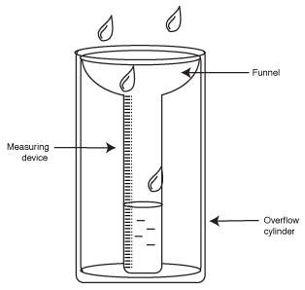
Rain Gauge
Used to measure the amount of rain fall
Units: centimeters & inches

Slide 8
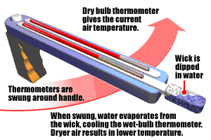
Sling Psychrometer
Used to measure relative humidity (how much moisture is in the air compared to the maximum that could be there)
Has two thermometers—one “wet bulb” and one “dry bulb”

Slide 9
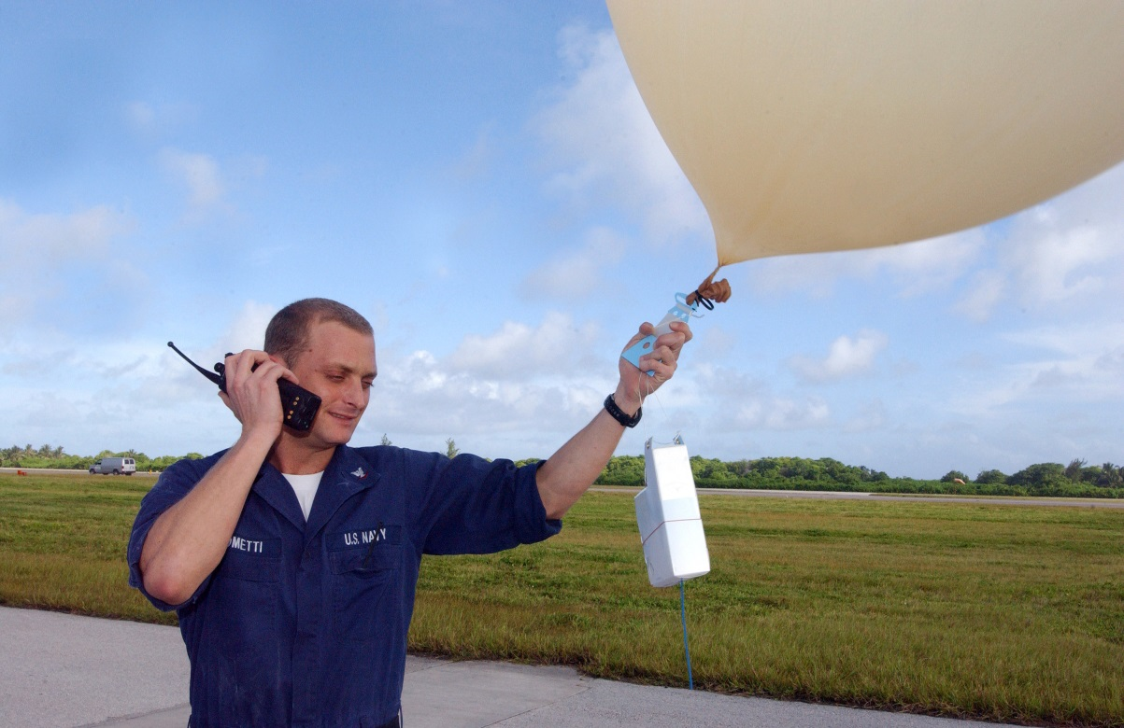
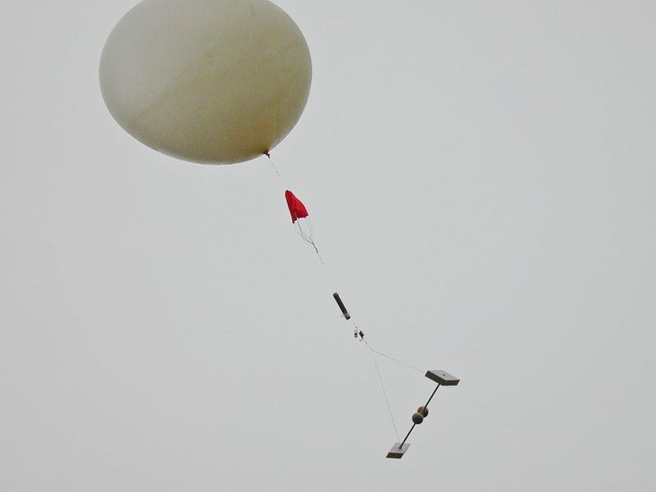
Weather Balloons
Used to measure weather conditions high in Earth’s atmosphere
Carry a variety of other weather instruments to achieve this purpose

Slide 10
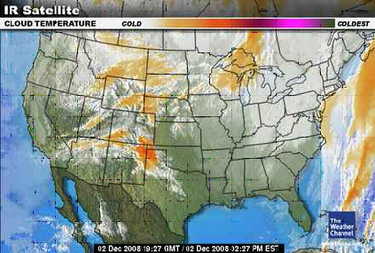
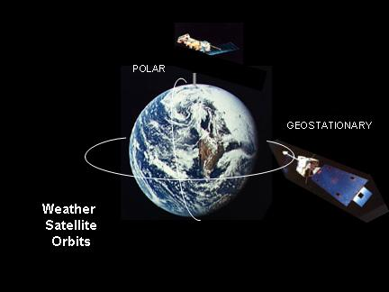
Weather Satellites
Used to measure atmospheric/weather conditions from far above Earth
Can track movements of large air masses, cloud cover, & precipitation

